Slide 1
Module 1: Epidemiology
Notes:
Welcome to the first module of this training of trainers: Epidemiology

Slide 2
Learning objectives
Understand of the major policy-practice gaps
Describe and interpret the epidemiology
Identify risk factors for infection, disease and death
Understand the importance of data for monitoring and evaluation
Notes:
At the end of this module, participants in training will be able to:
Understand the major policy-practice gaps in TB in children and adolescents
Describe the main epidemiological features of child and adolescent TB
Identify risk factors for TB infection and disease as well as TB-related death; and
Understand the value of age-disaggregated data for monitoring local epidemiology, identifying policy-practice gaps and evaluating programmatic response

Slide 3
Outline
Introduction and epidemiology of TB in children and adolescents
Fundamentals of TB: exposure | infection| disease
Risk factors for TB: infection | disease | severe disease
Factors related to transmission of TB
Routine TB recording and reporting
Case study quiz
Conclusion
Notes:
This is the outline of what we will cover in this module.
We started with an introduction and cover the epidemiology basics of TB in children and adolescents. We’ll then move onto the fundamentals of TB with respect to TB exposure, TB infection and TB disease.
We’ll then take a look at the risk factors for TB infection, disease and severe disease.
Then touch on some of the key factors related to the transmission of TB. We’ll then briefly introduce routine TB recording and reporting. Towards the end, there will be a case study quiz.
We’ll conclude the module with a summary of key points for you to take away.

Slide 4
Outline
Introduction and epidemiology of TB in children and adolescents
Fundamentals of TB: exposure | infection| disease
Risk factors for TB: infection | disease | severe disease
Factors related to transmission of TB
Routine TB recording and reporting
Case study quiz
Conclusion
Discussion
Discussion
Notes:
This is the outline of what we will cover in this module.
We started with an introduction and cover the epidemiology basics of TB in children and adolescents. We’ll then move onto the fundamentals of TB with respect to TB exposure, TB infection and TB disease.
We’ll then take a look at the risk factors for TB infection, disease and severe disease.
Then touch on some of the key factors related to the transmission of TB. We’ll then briefly introduce routine TB recording and reporting. Towards the end, there will be a case study quiz.
We’ll conclude the module with a summary of key points for you to take away.

Slide 5
Discussion – setting specific practices
Note to facilitator:
Suggested instructions:
These context specific discussion opportunities will occur repeatedly throughout this training. Here are some suggestions on how you might like to facilitate them, to run them in a time efficient manner.
Explain that the next 15 minutes will be devoted to sharing amongst your colleagues, about how things may work in your setting.
Explain that 3, or 4, questions will be shown on the presentation.
Then divide the questions amongst the groups. Some groups may need to discuss the same question.
Tell them they will have just 2 or 3 minutes to discuss in their small groups. Then you will discuss as a large group.
Allow 2-3 minute discussion time.
When this time is up, ask for everyone’s attention. And then ask for volunteers to comment on each question discussed. Request participants to keep their responses succinct so that the time allows for others to also contribute.
Acknowledge all responses and thank participants for sharing.
Be mindful of the time and try to wrap up discussions so that the full activity takes no more than 15 minutes.
Click for audible instructions
To discuss Question 1
To discuss Question 4
To discuss Question 2
To discuss Question 3
Notes:
These context specific discussion opportunities will occur repeatedly throughout this training.
Here are some suggestions on how you might like to facilitate them, to run them in a time efficient manner.
Explain that the next 15 minutes will be devoted to sharing amongst your colleagues, about how things may work in your setting.
Explain that 3, or 4, questions will be shown on the presentation.
Then divide the questions amongst the groups. Some groups may need to discuss the same question.
Tell them they will have just 2 or 3 minutes to discuss in their small groups. Then you will discuss as a large group.
When this time is up, ask for everyone’s attention. And then ask for volunteers to comment on each question discussed. Request participants to keep their responses succinct so that the time allows for others to also contribute.
Acknowledge all responses and thank participants for sharing.
Be mindful of the time and try to wrap up discussions so that the full activity takes no more than 15 minutes.

Slide 6
Discussion: setting specific practices
Note to facilitator:
Suggested instructions:
These context specific discussion opportunities will occur repeatedly throughout this training. Here are some suggestions on how you might like to facilitate them, to run them in a time efficient manner.
Explain that the next 15 minutes will be devoted to sharing amongst your colleagues, about how things may work in your setting.
Explain that 3, or 4, questions will be shown on the presentation.
Then divide the questions amongst the groups. Some groups may need to discuss the same question.
Tell them they will have just 2 or 3 minutes to discuss in their small groups. Then you will discuss as a large group.
Allow 2-3 minute discuss time.
When this time is up, ask for everyone’s attention. And then ask for volunteers to comment on each question discussed.
Ensure to steer participants back to the subject matter if they are drifting off topic. Acknowledge all responses and thank participants for sharing.
Be mindful of the time and try to wrap up discussions so that the full activity takes no more than 15 minutes.
Click for audible instructions
What are some of the challenges related to child and adolescent TB management in your setting?
1
What are common risk factors for infection and disease among the TB patients that you care for?
2
What are risk factors for death due to TB?
3
Which sub-groups of people with TB are most likely to transmit TB in the community?
4
To discuss Question 1
To discuss Question 4
To discuss Question 2
To discuss Question 3
Notes:
These context specific discussion opportunities will occur repeatedly throughout this training. Here are some suggestions on how you might like to facilitate them, to run them in a time efficient manner.
Explain that the next 15 minutes will be devoted to sharing amongst your colleagues, about how things may work in your setting.
Explain that 3, or 4, questions will be shown on the presentation.
Then divide the questions amongst the groups. Some groups may need to discuss the same question.
Tell them they will have just 2 or 3 minutes to discuss in their small groups. Then you will discuss as a large group.
Allow 2-3 minute discuss time.
When this time is up, ask for everyone’s attention. And then ask for volunteers to comment on each question discussed.
Ensure to steer participants back to the subject matter if they are drifting off topic. Acknowledge all responses and thank participants for sharing.
Be mindful of the time and try to wrap up discussions so that the full activity takes no more than 15 minutes.

Slide 7
What are some of the challenges related to child and adolescent TB management in your setting?
1
What are common risk factors for infection and disease among the TB patients that you care for?
2
What are risk factors for death due to TB?
3
Which sub-groups of people with TB are most likely to transmit TB in the community?
4
Notes:
[Prior to presenting an update of the knowledge of the epidemiology, it may be useful to have a discussion with training participants to have some idea of their level of understanding and to prompt thinking and encourage interaction with shared experience. Listed here are some questions for the group]

Slide 8
Introduction and epidemiology

Slide 9
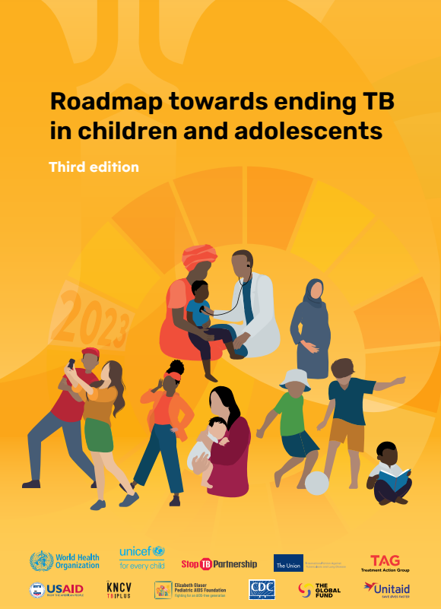
Child and adolescent TB: increasing public health focus
TB in children and adolescents has been neglected but there is now increasing attention by global and national TB programs.
Recent important steps include:
Evidence-based policy guidelines
Roadmaps developed by international agencies
Improved approaches to diagnosis
Range of regimens to treat disease and infection (TPT)
Availability of child-friendly formulations
Reporting of age-disaggregated data
Mothers, children and adolescents with TB commonly present for care within maternal and child health services .
Major policy-practice gaps remain, and implementation challenges exist at all levels of health services.
Notes:
TB in children and adolescents has traditionally been neglected but this is changing. The WHO global TB program has increased attention to the challenges of TB in children and adolescents over the last decade with the End TB Strategy and National TB Programs are also now doing the same with child TB Working Groups and/or NTP-focal person for child and adolescent TB at national level.
There have been WHO guidance for NTPs since 2006, with regular updates to recommendations for diagnosis, treatment and prevention of child and adolescent TB including drug-resistant MDR TB based on the most current evidence. The most recent guidelines were published in 2022. The Roadmap towards ending child TB was first developed by multiple international agencies including The Union and CDC with WHO and Unicef and others in 2013. The third edition was launched at the Union conference in 2023 and includes a greater focus on TB in adolescents. Improving diagnosis has been a constant focus of research and there is now a wider range of treatment options for disease and infection, as well as availability of child-friendly formulations of first- and second-line drugs.
Very important and relevant to our discussions today in this session is that the transition from paper-based to electronic TB registers has facilitated a shift to more granular reporting of age-disaggregated data. Given the varying age-related risks and burden of disease, the use of 5-year age bands – 0-4; 5-9; 10-14;15-19; and 20-24 years is much more useful to understand challenges and programmatic performance that the traditional 0-4; 5-14 and 15-24 years.
New recommendations support more decentralised models of care which is needed, especially as patients usually first present for care at maternal and child health services. We are yet to see the potential benefits of implementation of such approaches. Major policy-practice gaps remain and implementation challenges to strengthen child and adolescent TB programming exist at all levels of health services.

Slide 10
Notes:
If we have a look at the UN’s sustainable development goals….

Slide 11
Note to facilitator:
This slide is animated – goal 3 will automatically zoom out from the rest on slideshow mode.
Notes:
Good health and well-being are listed as goal 3…

Slide 12
TB and the Sustainable Development Goals
Note to facilitator:
This slide is automatically animated – the goals will automatically appear on slideshow mode.
3.1 Reduce maternal
mortality
3.2 Reduce child and neonatal mortality
3.3 End the epidemics of AIDS, tuberculosis, malaria & neglected tropical diseases and combat hepatitis, water-
borne and other communicable
diseases
3.a Strengthen implementation FCTC (tobacco)
3.b Access to affordable essential medicines and technologies
3.4 Reduce mortality due to NCDs & improve mental health
3.5 Strengthen prevention and treatment of substance
abuse
(narcotics,
alcohol)
3.6 Reduce mortality due to
road traffic
injuries
3.c Increased health financing and health workforce in developing countries
3.7 Universal
access to sexual and
reproductive health-care services
3.8 Achieve universal health coverage
3.9 Reduce deaths
and illness due to pollution
and
contamination
3.d Enhance capacity for early warning, risk reduction and management of national and global health risks
Notes:
Within this goal, are 9 targets specific to health and well-being.

Slide 13
TB and the Sustainable Development Goals
Note to facilitator:
This slide is automatically animated –goal 3.3 will automatically zoom out on slideshow mode.
3.3 End the epidemics of AIDS, tuberculosis, malaria & neglected tropical diseases and combat hepatitis, water-
borne and other communicable
diseases
3.3 End the epidemics of AIDS, tuberculosis, malaria & neglected tropical diseases and combat hepatitis, water-
borne and other communicable
diseases
3.1 Reduce maternal
mortality
3.2 Reduce child and neonatal mortality
3.3 End the epidemics of AIDS, tuberculosis, malaria & neglected tropical diseases and combat hepatitis, water-
borne and other communicable
diseases
3.a Strengthen implementation FCTC (tobacco)
3.b Access to affordable essential medicines and technologies
3.4 Reduce mortality due to NCDs & improve mental health
3.5 Strengthen prevention and treatment of substance
abuse
(narcotics,
alcohol)
3.6 Reduce mortality due to
road traffic
injuries
3.c Increased health financing and health workforce in developing countries
3.7 Universal
access to sexual and
reproductive health-care services
3.8 Achieve universal health coverage
3.9 Reduce deaths
and illness due to pollution
and
contamination
3.d Enhance capacity for early warning, risk reduction and management of national and global health risks
Notes:
Listed as 3.3. TB is the major infectious disease that causes death globally and so specific attention is rightly given to the TB epidemic in the third United Nations SDG.

Slide 14
TB and the Sustainable Development Goals
Note to facilitator:
This slide is automatically animated –these 3 goals will automatically zoom out on slideshow mode.
3.1 Reduce maternal
mortality
3.2 Reduce child and neonatal mortality
3.3 End the epidemics of AIDS, tuberculosis, malaria & neglected tropical diseases and combat hepatitis, water-
borne and other communicable
diseases
3.1 Reduce maternal
mortality
3.2 Reduce child and neonatal mortality
3.3 End the epidemics of AIDS, tuberculosis, malaria & neglected tropical diseases and combat hepatitis, water-
borne and other communicable
diseases
3.a Strengthen implementation FCTC (tobacco)
3.b Access to affordable essential medicines and technologies
3.4 Reduce mortality due to NCDs & improve mental health
3.5 Strengthen prevention and treatment of substance
abuse
(narcotics,
alcohol)
3.6 Reduce mortality due to
road traffic
injuries
3.c Increased health financing and health workforce in developing countries
3.7 Universal
access to sexual and
reproductive health-care services
3.8 Achieve universal health coverage
3.9 Reduce deaths
and illness due to pollution
and
contamination
3.d Enhance capacity for early warning, risk reduction and management of national and global health risks
Notes:
What is less well recognised is that TB is also an important cause of maternal and child mortality globally. One reason for this lack of awareness is that mothers and children and adolescents with TB present to and are managed within perinatal or child health services, not TB services – so greater disconnect from NTP. Another reason is that children with TB contribute much less to TB transmission and new infections in the community, so less of a public health risk. However, most countries globally prioritise maternal and child health – and therefore, attention to TB across the health sector is important.

Slide 15
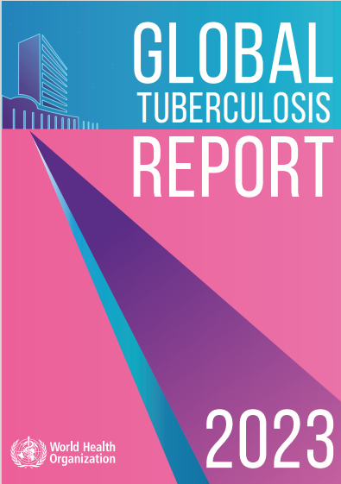
Epidemiology of TB among children and adolescents
Over 2 million children and adolescents develop TB each year globally.
The largest proportion occur in young children (< 5years) and the majority of these are not detected.
The vast majority of over 250,000 TB-related deaths in children and adolescents occur in young children with TB who have not been detected or treated.
TB burden in adolescents (10-19 years) is uncertain due to incomplete age-disaggregated data but most cases are in older adolescents (15-19 years).
TB and HIV are the major infectious diseases causing adolescent deaths globally.
TB in adolescents is commonly transmissible.
Notes:
Each year the WHO Global TB program provides estimates and programmatic data on TB in children and adolescents, charting progress and providing data by region and specific country. When training, it is useful to refer to the data from the most current report as well as provide national data for the country that the participants are from.
Globally, over 2 million children and adolescents develop TB each year and the largest proportion is in young children (< 5years).
TB causes around an estimated quarter of a million deaths in children and adolescents each year. The majority of these deaths are in infants and young children (<5 years) with TB who have not treated because they have not been detected or diagnosed.
Estimates of the TB burden in adolescents (10-19 yrs) will improve with more age-disaggregated data but in TB-endemic countries, the greatest proportion is in older adolescents (15-19 years) and TB in this age group is commonly transmissible. TB along with HIV are the major infectious diseases causing adolescent death.

Slide 16
Evidence-based policy well developed
WHO guidance for child TB in 2006 and 2014
Preventive treatment and MDR guidance 2020
Consolidated guidelines for child and adolescent TB 2022
Notes:
There have been important recent evidence-based recommendations made by the WHO for the diagnosis, treatment and prevention of TB, including drug-resistant MDR TB, in children and adolescents.
Consolidated guidelines were published in 2022 that combine the recent recommendations with other previous WHO recommendations that remain current and relevant – such as from previous child TB, TPT or MDR TB guidelines. The consolidated guidelines are accompanied by a comprehensive operational handbook that provides detailed and pragmatic implementation support.

Slide 17
..but wide policy-practice gaps persist
The treatment gap
Treatment success: 69% to 98%
Estimated that < 10% of MDR cases receive treatment.
Notes:
There is no lack of policy to support national guidelines. The actual challenge is the policy-practice gap.
Detection and treatment coverage for all TB are below target globally which leads to ongoing transmission, new infections and new TB cases. However, you will note that the TB detection and treatment gap is so much greater in children than adults; especially in young children, most TB cases are not detected due to the diagnostic challenges or are being diagnosed but not reported.
There is also a wide prevention gap. Only one-third of eligible young child contacts access TPT, which is far lower than TPT coverage in the other main high-risk group of people living with HIV.
If children are detected and treated, treatment outcomes can be excellent – though still remains low in some countries manly due to high loss to follow-up rates rather than deaths.
The diagnosis and treatment gap for drug-resistant TB in children is huge with only around 10% of all estimated MDR/RR TB receiving treatment – and almost all of these within just 6 countries even though there are cases of MDR/RR TB in almost all countries.
Therefore, a large proportion of the severe TB and TB deaths that occur in children represent missed opportunities for early detection and treatment or prevention by the health services.

Slide 18
Fundamentals of TB Exposure | Infection | Disease

Slide 19
Fundamentals of Tuberculosis
Tuberculosis (TB) is a common infectious disease caused by Mycobacterium tuberculosis.
TB is an important cause of death and can cause long-term sequelae.
Understanding risk factors for TB infection and disease among children and adolescents is critical for improved prevention and management.
Exposure
Infection
Disease
Notes:
Let’s revisit the fundamentals. TB is caused by Mycobacterium tuberculosis and we should recognise that TB is not only an important cause of death but can also cause long-term sequelae or disability.
Many people with pulmonary TB are left with some long-term restrictive lung disease even after successful treatment while some forms of extrapulmonary disease especially Tb of the brain or spine are commonly associated with major disability in survivors.
It is helpful to consider the main epidemiological steps from exposure to infection to disease (and death) to think through the risk factors but also the potential for interventions to prevent this progression. Understanding risk factors for TB infection and disease among children and adolescents is critical for improved prevention and management.

Slide 20
From exposure to disease
Exposure
Infection
Disease
Not everyone exposed is infected, and not everyone who is infected will develop disease.
Majority of children who progress to TB disease do so within two years following exposure – most in less than a year.
Progression to disease most rapid in infants and young children, often within 3 months.
Notes:
For example, knowing that up to around one half of children exposed as a household TB contact will be infected, and that the young children are then at high risk of disease and of rapid progression to disease is really critical to performing contact investigation routinely and promptly following diagnosis of someone with bacteriologically positive pulmonary TB.

Slide 21
Difference between TB infection and disease
TB infection | TB disease
TB bacilli mainly dormant and locally contained. | TB bacilli multiplying and may be spreading, (dissemination).
Person is well/has no symptoms. | Person is sick and has TB symptoms.
Cannot transmit TB to others. | Can transmit TB to others.
Treatment of infection or TPT prevents progression to TB disease. | TB treatment cures disease, prevents death and stops transmission.
The reality is a spectrum.
Important to consider this when ruling out active TB before initiating treatment for infection or TPT, especially in adolescents.
Notes:
The reality is a spectrum with exposure causing infection at one end transitioning to active disease in around 10% of people overall. The transition includes a period when the person has developed active disease but is still asymptomatic – commonly known as subclinical disease. They can often be infectious at this stage but do not present for care as they feel well. It is important to consider the spectrum when ruling out active TB before initiating treatment for infection or TPT, especially in adolescents.
When someone has what is often referred to as “latent” TB infection, the TB bacilli are dormant or “sleeping”. TB infection cannot be transmitted but it can be treated with TPT to reduce the chances of it becoming active and progressing to active TB. Transmission occurs once the bacilli become more active causing subclinical disease in the lungs which then progresses to symptomatic pulmonary TB disease.

Slide 22
Risk factors for TB Infection | Disease | Severe disease

Slide 23
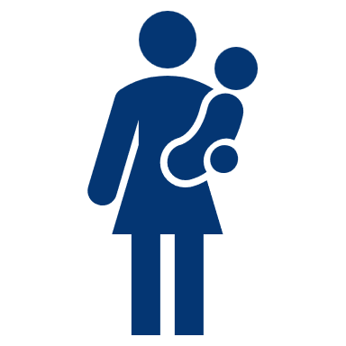
Risk factors for TB infection in children and adolescents
Contact with a person who has TB
Closeness of contact
Duration of contact
Sleeping in same room
Source case
Smear positivity
Bacteriologic confirmation
Cavities on CXR
Increased exposure
Living in high TB endemic communities
Living with HIV
Crowded, poorly ventilated environment
Notes:
The risks for infection with Mycobacterium tuberculosis are well known. Infants and young children are at particular risk of being infected within the household while exposure to TB and infection in older children and adolescents becomes increasingly common in the wider community. Most countries prioritise the screening of contacts of people with bacteriologically positive pulmonary TB as they pose the greatest risk for transmission.

Slide 24
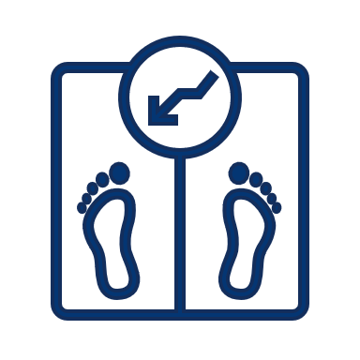
Risk factors for TB disease in children and adolescents
Disease
Severe disease
Recent infection
Age
Young child (especially < 2 years)
Older adolescent
HIV infection
Other immunosuppression or co-morbidities
Malnutrition
Post-measles
Diabetes
Pregnancy
Immunosuppressive therapy
Young age
Especially < 2 years
HIV infection
Malnutrition
Not BCG vaccinated
Notes:
If infected, the risks for developing disease are also well established and usually relate to reduced immunity – such as with young age, puberty or pregnancy - or to immunodeficiency caused by comorbidities such as severe malnutrition or HIV infection. Infants and young children are at especially high risk of disease after infection, often severe, disseminated forms of TB, which will usually develop within months of exposure. This informs the rationale for prompt contact screening for active TB and for TPT on the basis of exposure.

Slide 25
The risk of TB disease is higher among young children
TB disease in children who have been infected
Adapted from Marais BJ, Gie RP, Schaaf HS, Hesseling AC, Obihara CC, Starke JJ, Enarson DA, Donald PR, Beyers N. The natural history of childhood intra-thoracic tuberculosis: a critical review of literature from the pre-chemotherapy era. Int J Tuberc Lung Dis. 2004 Apr;8(4):392-402. PMID: 15141729
Notes:
The risk of TB disease following infection is much higher in young children than older children and increases again in adolescents. The risk is especially high in infants and children less than two years and the majority of young children will develop disease within 3 months following infection. This is the rationale for TPT for young child contacts and demonstrates why contact investigation should be routine and prompt following diagnosis of a person with bacteriologically confirmed TB.

Slide 26
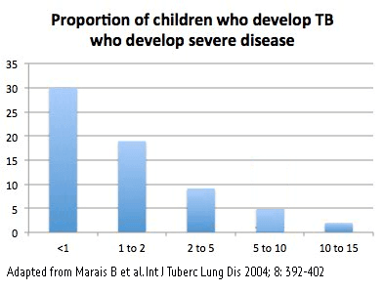
The risk of severe TB disease is higher among young children
Proportion of children who develop TB who develop severe disease
Age
Adapted from Marais BJ, Gie RP, Schaaf HS, Hesseling AC, Obihara CC, Starke JJ, Enarson DA, Donald PR, Beyers N. The natural history of childhood intra-thoracic tuberculosis: a critical review of literature from the pre-chemotherapy era. Int J Tuberc Lung Dis. 2004 Apr;8(4):392-402. PMID: 15141729
Notes:
The proportion of children with TB who present with severe forms of disease is also highest in young children. The main benefit of newborn BCG is to reduce the risk of severe disease in young children,

Slide 27
The risk of TB disease and severe TB disease is high among children living with HIV, especially those not on ART
HIV-positive
HIV-negative
Cases/100 000
Hesseling AC, Cotton MF, Jennings T, Whitelaw A, Johnson LF, Eley B, Roux P, Godfrey-Faussett P, Schaaf HS. High incidence of tuberculosis among HIV-infected infants: evidence from a South African population-based study highlights the need for improved tuberculosis control strategies. Clin Infect Dis. 2009 Jan 1;48(1):108-14. doi: 10.1086/595012. PMID: 19049436.
Notes:
Children and adolescents living with HIV are more likely to be exposed to TB, including when accessing health services. HIV infection is also associated with a much higher risk of disease following infection. The data here are in children who were not receiving ART. ART greatly reduces the risk but not entirely.

Slide 28
TB-associated risks for adolescents
Exposure to TB common due to more frequent and wider social contacts than other ages.
Biological/immunological changes such as changes associated with puberty or pregnancy.
Prevalence of comorbidities increases during adolescence:
Cigarette smoking
Diabetes
HIV
Notes:
The risk of exposure to TB and infection increases during adolescence due to more frequent and wider social contacts
The risk of developing disease following infection increases during adolescence
Biological changes such as changes associated with puberty
The prevalence of at-risk factors increases during adolescence
Cigarette smoking
Diabetes
HIV
Malnutrition
Pregnancy

Slide 29
Factors related to TB transmission

Slide 30
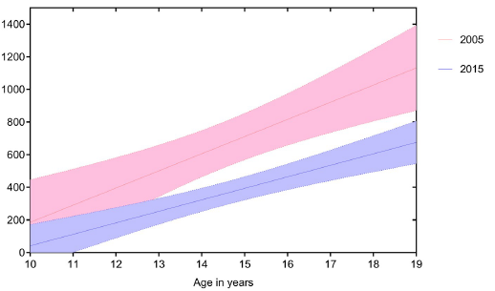
Transmission risk increases with age
2005
TB cases per 100 000
2015
Age in years
Bunyasi EW, Mulenga H, Luabeya AKK, Shenje J, Mendelsohn SC, Nemes E, Tameris M, Wood R, Scriba TJ, Hatherill M. Regional changes in tuberculosis disease burden among adolescents in South Africa (2005-2015). PLoS One. 2020 Jul 1;15(7):e0235206. doi: 10.1371/journal.pone.0235206. PMID: 32609738; PMCID: PMC7329123.
Notes:
In TB endemic settings, sharp increase in incidence of bacteriologically confirmed TB in older adolescents
The risk of transmission of TB increases as bacteriologically confirmed TB is increasingly common with age, especially in older adolescents (15-19 years)

Slide 31
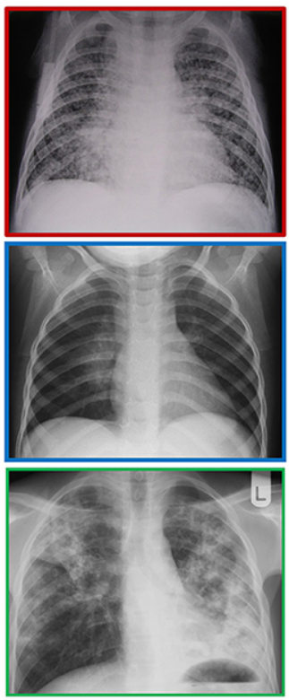
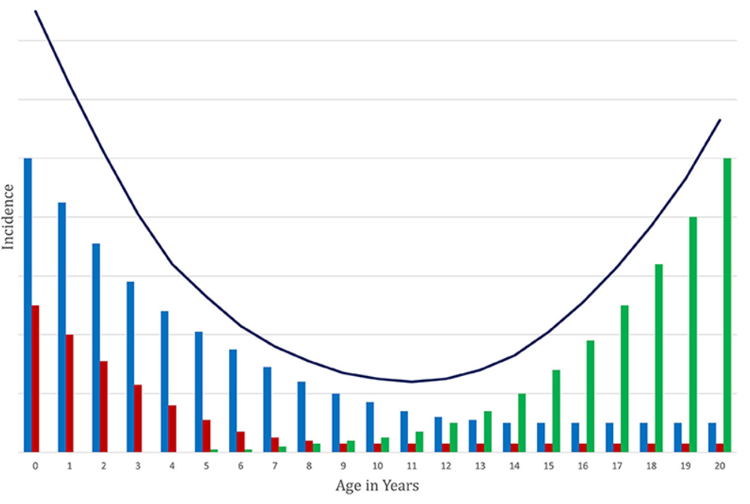
Age-related spectrum of TB in children and adolescents
Young at high risk of severe disease
Bacteriological
confirmation more common
Clinical diagnosis often required
Seddon JA, Chiang SS, Esmail H, Coussens AK. The Wonder Years: What Can Primary School Children Teach Us About Immunity to Mycobacterium tuberculosis? Front Immunol. 2018 Dec 13;9:2946. doi: 10.3389/fimmu.2018.02946. PMID: 30619306; PMCID: PMC6300506.
Notes:
The age-related risks for TB that occur from infancy to adulthood are shown in this diagram. The slide also shows how the pattern of clinical and radiological disease also changes across the age spectrum. This reflects the challenges for diagnosis. Adolescents commonly present with pulmonary TB that is similar to adults, sputum positive and similar CXR changes. Children present with a range of pulmonary or extrapulmonary TB types. Pulmonary TB is often characterised by hilar lymph node enlargement that can be challenging to detect on chest X-ray and is paucibacillary so more difficult to confirm, Young children are particularly at risk of severe disseminated forms such as TB meningitis, and the main purpose of newborn BCG is to protect against this devastating disease.

Slide 32
Site of disease presentation
Most TB cases are pulmonary TB:
75% in younger children
90% in older children
Extrapulmonary TB presentation varies with age:
Lymph node TB, pleural TB and disseminated TB are commonest forms
TB treatment success rate in children is high.
TB is often misdiagnosed as HIV, pneumonia or malnutrition.
Notes:
As in adults, most TB cases in children are pulmonary TB but there is usually a higher proportion of extrapulmonary TB cases in children which is not surprising given that dissemination from the lungs is more common.
The presentation of extra-pulmonary TB varies with age: pleural TB, abdominal and osteoarticular TB tend to be more common in older children and adolescents while TB meningitis and miliary TB tend to be more common in young children. The commonest site of lymph node TB is cervical.
TB treatment success rate in children is usually high (>90%) - if treated and treatment complete. The children with TB who die are mainly young children who were not detected and so did not access treatment
TB is often diagnosed as HIV, pneumonia or malnutrition. TB is commonly missed in these children especially children with severe pneumonia – TB can present with acute symptoms – or children with severe malnutrition as symptoms aside from weight loss can be minimal. It is always important to consider TB in these children as well as children with acute neurological disease such as meningitis.

Slide 33
Multidrug resistant TB
Incidence in children and adolescents reflect epidemiology of MDR/RR TB in adults in same community.
Infection and disease risks for drug resistant TB following exposure are similar to drug-susceptible TB.
Major case detection and treatment gap, especially in children.
New cases of MDR/RR TB from primary transmission much more common than from previous TB treatment.
Improving treatment options – shorter, safer, oral.
TPT recommendations for contacts of drug-resistant TB.
Notes:
The growing number of drug resistant (DR) TB cases poses an increasing risk to children and adolescents
The annual estimated global burden of MDR TB in children is 32,000 of which only 10-20% are reported as started on second line treatment
Children are most likely to acquire DR TB by primary transmission, often from adults with whom they are in close contact, rather than due to previous TB treatment
The treatment duration is longer, more costly and associated with greater toxicity compared to first-line treatment for drug-susceptible TB
There is now evidence that MDR TB in contacts can be prevented by TPT.

Slide 34
Routine TB recording and reporting

Slide 35
Routine TB recording and reporting
All children and adolescents diagnosed with TB must be reported to the NTP.
All contact investigations and use of TPT should be registered.
Data are critical to determine and monitor epidemiology such as:
Numbers and proportions of total TB caseload and by five-year age bands: 0-4; 5-9; 10-14; and 15-19 years
By TB site; bacteriological confirmation; drug susceptibility
Treatment outcomes
Coverage of contact screening
TPT initiation and completion
Baseline data are also critical to evaluate gaps and programmatic response
Notes:
All children and adolescents diagnosed with TB must be reported to the NTP. This is the same as for anyone initiated on TB treatment. Entries into other registers such as laboratory registers should be routine. Most NTPs have or should have contact and TPT registers.
Data are critical to evaluate and monitor local epidemiology. TB in young children directly reflects ongoing and recent transmission in the community. For prevention and case finding, important programmatic indicators include contact screening coverage as well as TPT initiation and completion.
Local age-disaggregated data provide an important baseline for monitoring, identifying gaps and challenges, defining resource needs and priority activities
Data are critical for epidemiology and evaluation of gaps such as:
Total numbers and proportions and by five-year age bands of TB site; bacteriological confirmation; drug susceptibility
Treatment outcomes
Coverage of contact screening and TPT uptake
Example of indicators include:
Proportion of TB in 0-14 years among all TB cases: estimated to be 10-20%
Proportion of children and adolescents by age group: In high burden settings, the age groups with the higher proportions are expected to be 0-4 years and 15-19 years
Proportion of PTB versus EPTB diagnosed: EPTB accounts for approximately 25% of child TB cases in young children (<5 years) and about 10% in older children and adolescents (5-19 years)
Proportion by age group bacteriologically confirmed
The proportions may indicate that TB and/or EPTB is being under-detected (and under-treated) or over-diagnosed (and over-treated) within specific age groups

Slide 36
Case study quiz – group exercise
Note to facilitator:
Suggested instructions:
Welcome to the first introductory activity featuring case scenarios.
The next 8 slides will introduce the participants to the idea of case studies using multiple choice quiz questions. This first exercise will be done altogether as an introduction to working with case scenarios.
It is recommended that the facilitator move straight from the lecture into this case quiz.
As the facilitator, simply read out loud the case scenario, followed by the question and potential answers. Allow participants a couple of moments to decide on their answer. Then ask for those who think (a) is the correct answer to raise their hands. Then, those who think (b) is correct, to raise their hands, and so on. This is a fun exercise, and it is not necessary to count every hand, only to obtain a general impression.
Once the MCQs are complete, flick to the next slide which has the model answer.
Ask if everyone is together and understands, and if there are any differing opinions, or questions.
Click for audible instructions
Notes:
Suggested instructions:
…”We will now work through a case study quiz to pick out some valuable learning points from this lecture.
We will do this short activity altogether. I will read the case scenario out, followed by the question and potential answers. I will then you all a couple of moments to decide on your answer. I will then ask for those who think (a) is correct to raise their hands; then for those who think (b) is correct to raise their hands and so on. I’ll then show a model answer, and we can discuss further if there is anyone who disagrees.”…

Slide 37
Case study #1
KM, a 10-month-old, presents to the health centre with cough, fever & poor weight gain.
She lives with her parents and five siblings in a two-room house with one window. She sleeps in the same bed as her parents.
KM’s mother recently began treatment for bacteriologically confirmed pulmonary TB. Before she began treatment, she was coughing frequently.
On clinical evaluation, KM has signs of severe illness: shortness of breath, fever, underweight, and is diagnosed with miliary TB after chest radiography.
She has no BCG scar and is HIV negative.
Which of the following increased KM’s risk for TB exposure and infection:
 | Sleeping in the same bed as her parents.
 | Crowded living conditions.
 | Exposure to an adult with pulmonary TB prior to starting TB treatment.
 | All of the above.

Slide 38
Case study #1
KM, a 10-month-old, presents to the health centre with cough, fever & poor weight gain.
She lives with her parents and five siblings in a two-room house with one window. She sleeps in the same bed as her parents.
KM’s mother recently began treatment for bacteriologically confirmed pulmonary TB. Before she began treatment, she was coughing frequently.
On clinical evaluation, KM has signs of severe illness: shortness of breath, fever, underweight, and is diagnosed with miliary TB after chest radiography.
She has no BCG scar and is HIV negative.
Which of the following increased KM’s risk for TB exposure and infection:
 | Sleeping in the same bed as her parents.
 | Crowded living conditions.
 | Exposure to an adult with pulmonary TB prior to starting TB treatment.
X | All of the above.

Slide 39
Case study #1
KM, a 10-month-old, presents to the health centre with cough, fever & poor weight gain.
She lives with her parents and five siblings in a two-room house with one window. She sleeps in the same bed as her parents.
KM’s mother recently began treatment for bacteriologically confirmed pulmonary TB. Before she began treatment, she was coughing frequently.
On clinical evaluation, KM has signs of severe illness: shortness of breath, fever, underweight, and is diagnosed with miliary TB after chest radiography.
She has no BCG scar and is HIV negative.
Which of the following increased KM’s risk for TB disease:
 | KM’s young age ( < 2 years old)
 | KM’s HIV status
 | It’s likely that KM had chronic lung disease to start with.
 | All of the above

Slide 40
Case study #1
KM, a 10-month-old, presents to the health centre with cough, fever & poor weight gain.
She lives with her parents and five siblings in a two-room house with one window. She sleeps in the same bed as her parents.
KM’s mother recently began treatment for bacteriologically confirmed pulmonary TB. Before she began treatment, she was coughing frequently.
On clinical evaluation, KM has signs of severe illness: shortness of breath, fever, underweight, and is diagnosed with miliary TB after chest radiography.
She has no BCG scar and is HIV negative.
Which of the following increased KM’s risk for TB disease:
X | KM’s young age ( < 2 years old)
 | KM’s HIV status
 | It’s likely that KM had chronic lung disease to start with.
 | All of the above

Slide 41
Case study #1
KM, a 10-month-old, presents to the health centre with cough, fever & poor weight gain.
She lives with her parents and five siblings in a two-room house with one window. She sleeps in the same bed as her parents.
KM’s mother recently began treatment for bacteriologically confirmed pulmonary TB. Before she began treatment, she was coughing frequently.
On clinical evaluation, KM has signs of severe illness: shortness of breath, fever, underweight, and is diagnosed with miliary TB after chest radiography.
She has no BCG scar and is HIV negative.
Which of the following increased KM’s risk for severe TB disease:
 | KM’s young age (< 2 years old)
 | Underweight
 | Likely did not have a BCG vaccination
 | All of the above

Slide 42
Case study #1
KM, a 10-month-old, presents to the health centre with cough, fever & poor weight gain.
She lives with her parents and five siblings in a two-room house with one window. She sleeps in the same bed as her parents.
KM’s mother recently began treatment for bacteriologically confirmed pulmonary TB. Before she began treatment, she was coughing frequently.
On clinical evaluation, KM has signs of severe illness: shortness of breath, fever, underweight, and is diagnosed with miliary TB after chest radiography.
She has no BCG scar and is HIV negative.
Which of the following increased KM’s risk for severe TB disease:
 | KM’s young age (< 2 years old)
 | Underweight
 | Likely did not have a BCG vaccination
X | All of the above

Slide 43
Case study #1
KM, a 10-month-old, presents to the health centre with cough, fever & poor weight gain.
She lives with her parents and five siblings in a two-room house with one window. She sleeps in the same bed as her parents.
KM’s mother recently began treatment for bacteriologically confirmed pulmonary TB. Before she began treatment, she was coughing frequently.
On clinical evaluation, KM has signs of severe illness: shortness of breath, fever, underweight, and is diagnosed with miliary TB after chest radiography.
She has no BCG scar and is HIV negative.
Which critical intervention was missed at the time that KM’s mother was diagnosed with TB?
 | Screening of all household contacts for TB
 | Mother should have been hospitalised
 | TPT for eligible contacts such as KM
 | a) and c)
 | All of the above

Slide 44
Case study #1
If all household contacts had been appropriately screened and started on TPT to treat TB infection, then KM’s severe TB disease could have been prevented.
There is no reason to routinely admit TB patients to hospital unless they are ill and requiring supportive treatment.
KM, a 10-month-old, presents to the health centre with cough, fever & poor weight gain.
She lives with her parents and five siblings in a two-room house with one window. She sleeps in the same bed as her parents.
KM’s mother recently began treatment for bacteriologically confirmed pulmonary TB. Before she began treatment, she was coughing frequently.
On clinical evaluation, KM has signs of severe illness: shortness of breath, fever, underweight, and is diagnosed with miliary TB after chest radiography.
She has no BCG scar and is HIV negative.
Which critical intervention was missed at the time that KM’s mother was diagnosed with TB?
 | Screening of all household contacts for TB
 | Mother should have been hospitalised.
 | TPT for eligible contacts such as KM
X | a) and c)
 | All of the above

Slide 45
Discussion – setting specific practices

Slide 46
Discussion: setting specific practices
Which registers are used to record TB program activities for children and adolescents in your setting and which age bands are used for reporting?
1
What data from TB programme would be useful in evaluating local epidemiology for child and adolescent TB?
2
Should TB program regularly share notification data with healthcare providers, and why might this be useful?
3

Slide 47
Which registers are used to record TB program activities for children and adolescents in your setting and which age bands are used for reporting?
1
What data from TB program would be useful in evaluating local epidemiology for child and adolescent TB?
2
Should TB program regularly share notification data with healthcare providers, and why might this be useful?
3

Slide 48
Conclusion Summary of key points

Slide 49
Summary of key learning points
TB is an important cause of sickness and death in children and adolescents, especially young children < 5 years.
Identifying risk factors for TB is an important step in assessing a child or adolescent for TB.
Adolescents are at increased risk of exposure and infection, as well as of disease that can be readily transmitted.
Local age-disaggregated data provide an important baseline for monitoring, identifying gaps and challenges, defining resource needs and priority activities.

Slide 50
References
Global tuberculosis report 2023. Geneva: World Health Organization; 2023. Licence: CC BY-NC-SA 3.0 IGO.
Martinez L, Cords O, Horsburgh CR, Andrews JR; Pediatric TB Contact Studies Consortium. The risk of tuberculosis in children after close exposure: a systematic review and individual-participant meta-analysis. Lancet. 2020 Mar 21;395(10228):973-984. doi: 10.1016/S0140-6736(20)30166-5. PMID: 32199484; PMCID: PMC7289654.
Bunyasi EW, Mulenga H, Luabeya AKK, Shenje J, Mendelsohn SC, Nemes E, Tameris M, Wood R, Scriba TJ, Hatherill M. Regional changes in tuberculosis disease burden among adolescents in South Africa (2005-2015). PLoS One. 2020 Jul 1;15(7):e0235206. doi: 10.1371/journal.pone.0235206. PMID: 32609738; PMCID: PMC7329123.
Snow KJ, Cruz AT, Seddon JA, Ferrand RA, Chiang SS, Hughes JA, Kampmann B, Graham SM, Dodd PJ, Houben RM, Denholm JT, Sawyer SM, Kranzer K. Adolescent tuberculosis. Lancet Child Adolesc Health. 2020 Jan;4(1):68-79. doi: 10.1016/S2352-4642(19)30337-2. Epub 2019 Nov 18. Erratum in: Lancet Child Adolesc Health. 2019 Nov 27;: PMID: 31753806; PMCID: PMC7291359.
Seddon JA, Chiang SS, Esmail H, Coussens AK. The Wonder Years: What Can Primary School Children Teach Us About Immunity to Mycobacterium tuberculosis? Front Immunol. 2018 Dec 13;9:2946. doi: 10.3389/fimmu.2018.02946. PMID: 30619306; PMCID: PMC6300506.
Hesseling AC, Cotton MF, Jennings T, Whitelaw A, Johnson LF, Eley B, Roux P, Godfrey-Faussett P, Schaaf HS. High incidence of tuberculosis among HIV-infected infants: evidence from a South African population-based study highlights the need for improved tuberculosis control strategies. Clin Infect Dis. 2009 Jan 1;48(1):108-14. doi: 10.1086/595012. PMID: 19049436.
Marais BJ, Gie RP, Schaaf HS, Hesseling AC, Obihara CC, Starke JJ, Enarson DA, Donald PR, Beyers N. The natural history of childhood intra-thoracic tuberculosis: a critical review of literature from the pre-chemotherapy era. Int J Tuberc Lung Dis. 2004 Apr;8(4):392-402. PMID: 15141729

